Slide 1
CONTROL OF MICROBIAL GROWTH

Slide 2
INTRODUCTION
1- Ignatz Semmelweis introduced hand-washing with chlorinated lime by hospital personnel to reduce infections.
2- Joseph Lister introduced aseptic surgery, including heat sterilization of instruments and disinfection of wounds.
3-Microbial growth can be controlled by physical and chemical methods.
4- Control of microbial growth can prevent infections and food spoilage.
5- Sterilization is the process of destroying all microbial life on an object.
6- Disinfection is the process of reducing or inhibiting microbial growth.
Go TO Table (1)

Slide 3
TABLE-ONE
Terminology Related to the Control of Microbial Growth
TERM |  | DEFINITION | COMMENTS
Terms Related to Destruction of Organisms
Sterilization | The process of destroying all forms of microbial life on an object or in a material. This includes the destruction of endospores-the most resistant form of microbial life. Sterilization is absolute; there are no degrees of sterilization. |  | Typical temperatures required: moist heat; 121 C for 15 minutes; dry heat, 170 for 120 minutes. Other methods are ionizing radiation and gases such as ethylene oxide.
Disinfection | The process of destroying vegetative pathogens but not necessarily endospores or viruses. Usually, a disinfectant is a chemical applied to an object or a material. Disinfectants tend to reduce or inhibit growth; they usually do not sterilize. |  | Term usually applied to use of liquid chemical solutions on surfaces or to elimination of pathogens in water- for example, by chlorination.
Antisepsis | Chemical disinfection of the skin, mucous membranes, or other living tissues. |  | Term especially applied to treatment of wounds. Antisepsis is a specific kind of disinfection.
Germicide | A chemical agent that rapidly kills microbes but not necessarily their endospores |  | A bactericide kills bacteria, a sporicide kills endospores, a fungicide kills fungi, a virucide kills viruses, and an amoebicide kills amoebas.

Slide 4
Terms Related to Suppression of Organisms
TERM | DEFINITION | COMMENTS
Bacteriostasis | A condition in which bacterial growth and multiplication are inhibited, but the bacteria are not killed. If the bacteriostatic agent is removed, bacterial growth and multiplication may resume. Fungistasis refers to the inhibition of fungi growth | Refrigeration is bacteriostatic; many chemicals such as dyes are bacteriostatic rather than bactericidal.
Asepsis | The absence of pathogens from an object or area. Aseptic techniques are designed to prevent the entry of pathogens into the body. Whereas surgical asepsis is designed to exclude all microbes. Medical asepsis is designed to exclude microbes associated with communicable diseases. | Air filtration, ultraviolet lights, personal masks, gloves, and gowns, and instrument sterilization are all factors in achieving asepsis.
Degerming | The removal of transient microbes from the skin by mechanical cleaning or by the use of an antiseptic. | For routine injections, alcohol swabs are often used; before surgery, iodine-containing products are often used.
Sanitization | The reduction of pathogens on eating utensils to safe public health levels by mechanical cleaning or chemicals. | Any chemicals must be compatible with safety and palatability of foods.

Slide 5
Conditions Influencing Microbial Control
1- A general rule of disinfection is to try to kill the most resistant microbes that can be found on the object to be disinfected.
2- the number and species of microorganisms present will affect the rate of disinfection.

Slide 6
A- Temperature
1-Biochemical reactions occur more rapidly at warm temperatures.
2-Disinfectant activity is enhanced by warm temperatures.

Slide 7
B-Types of Microbes
1- Gram-positive bacteria are generally more susceptible to disinfectants than gram-negative bacteria.
2- Pseudomonads can grow in some disinfectants and antiseptics.
3- Mycobacteria also are resistant to some disinfectants
4-The endospores of bacteria and cysts of protozoans are also highly resistant to chemical agent, as are some viruses

Slide 8
C-Physiological State Of The Microbe
1- An actively growing microorganism tends to be less resistant to chemical agents than an older microorganism.
2-Endospores are more resistant to chemical agents and physical methods. The endospores of the resistant strains of Clostridium botulinum, for example, can withstand boiling for several hours.

Slide 9
D-Environment
1-Organic mater and pH level frequently interfere with the actions of chemical control agents.
2- Example of such organic matter include vomit, feces, pus, and food.
Bacteria in cream are protected by proteins and fats and can survive more heat than bacteria in skim milk.
3- Heat is much more effective in killing bacteria under acidic conditions than at a neutral pH.
4- Some disinfectants also work best at an acidic pH.

Slide 10
Actions of Microbial Control Agents
A-Alteration of Membrane Permeability
1-The susceptibility of the plasma membrane is due to its lipid and protein components.
2-Certain chemical control agents damage the plasma membrane by altering its permeability like ammonium compounds.

Slide 11
B-Damage to Protein and Nucleic Acids
1-Some microbial control agents damage cellular proteins by breaking hydrogen and covalent bonds like disulfide bridges in proteins.
2- Other agents interfere with DNA and RNA replication and protein synthesis.
3. Because DNA and RNA carry the genetic message, damage to them by radiation or chemicals is frequently lethal to the cell; this damage prevents both replication and normal functioning.

Slide 12
Rate of Microbial Growth
Bacterial populations subjected to heat or antimicrobial chemicals die at a constant rate.
Such a death curve can be plotted logarithmically.

Slide 13
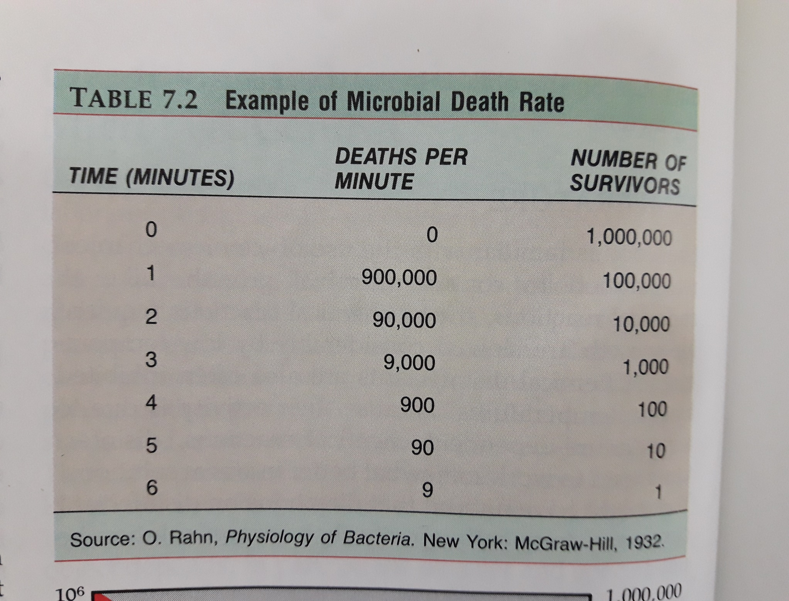

Slide 14
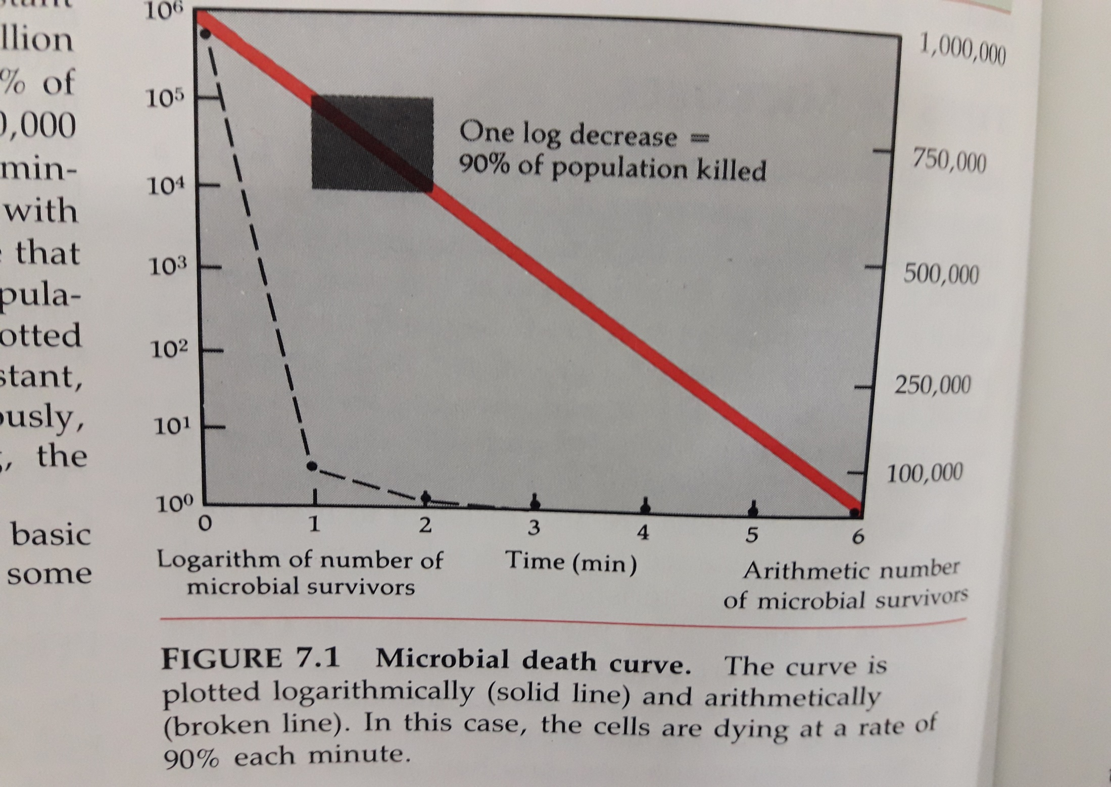

Slide 15
Physical Methods of Microbial Control
A-HEAT
Heat is frequently used to eliminate microorganisms ; it is economical and easily controlled.
The mechanism or action by which heat kills microbes is denaturation of enzymes.
Thermal death point (TDP) is the lowest temperature at which all bacteria in a liquid culture will be killed in 10 minutes.
Thermal death time (TDT) is the length of time required to kill all bacteria in a liquid culture at a given temperature.
Decimal reduction time (DRT) is the length of time in which 90% of a bacterial population will be killed at a given temperature.

Slide 16
Moist Heat
Boiling (100C) kills many vegetative cells and viruses within 10 minutes.
Endospores and some viruses, however, are not destroyed so quickly. One type of hepatitis virus, for example, can survive up to 30 minutes of boiling, and some bacterial endospores have resist boiling temperatures for more than 20 hours. Boiling is therefore not always a reliable sterilization procedure.
Reliable sterilization with moist heat requires temperature above that of boiling water. These high temperatures are most commonly achieved by steam under pressure in an autoclave.

Slide 17
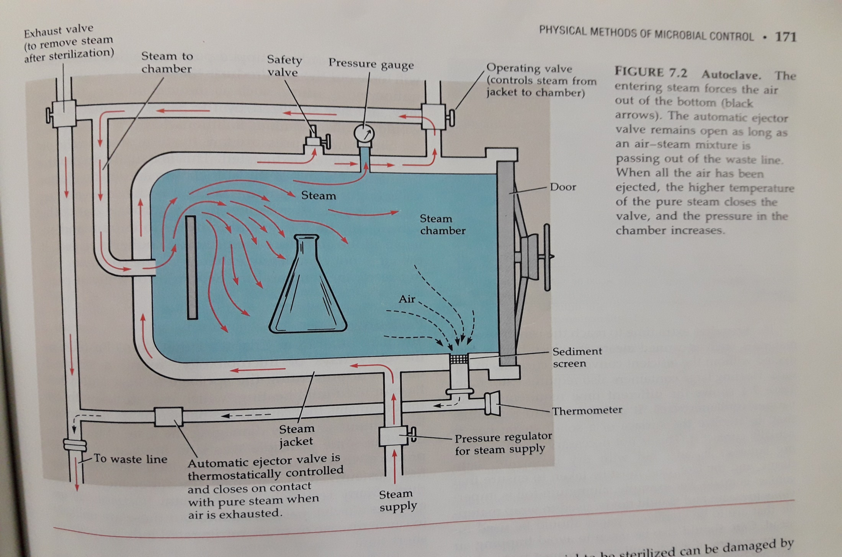
Figure 7.2

Slide 18
The most commonly used temperature is 121 C at a pressure of 15 pounds per square inch (psi) for 15 minutes. Autoclaving (steam under pressure) is the most effective method of moist heat sterilization. The steam must directly contact the material to be sterilized. There are relations between the (psi) and the temperature required; and also between the liquid volume and the sterilization time in minutes.
Sterilization times in the autoclave include the time needed for the contents of the containers to reach sterilization.

Slide 19
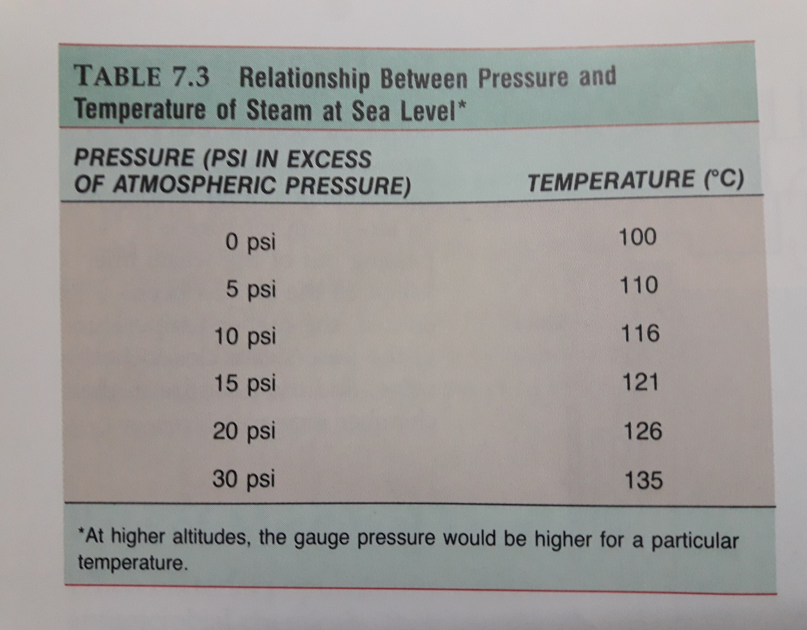
Table 7.3

Slide 20
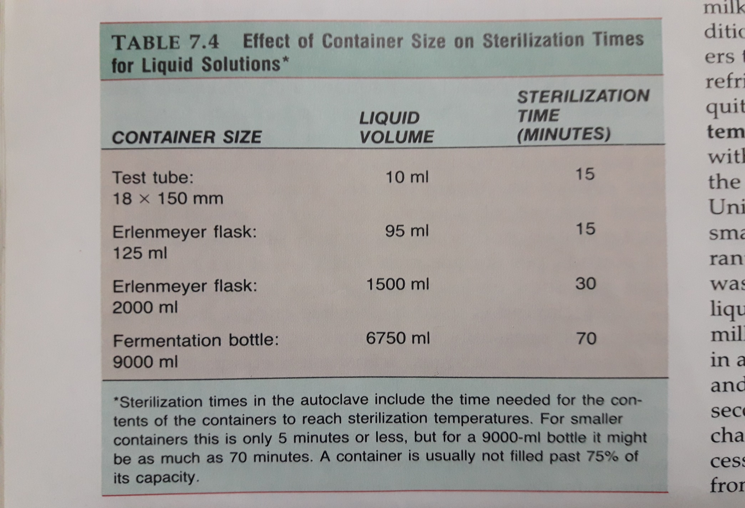
Table 7.4

Slide 21
Pasteurization
Pasteur used mild heating, which was sufficient to kill organisms that caused the particular spoilage problem without seriously damaging the taste of the product. The same principle was later applied to milk to produce what we now call pasteurized milk. Milk was first pasteurized to eliminate the tuberculosis bacterium. Many relatively heat-resistant (thermoduric) organisms survive pasteurization, but these are unlikely to cause disease or cause refrigerated milk to spoil in a short time.
Classic pasteurization treatment of milk
The milk exposed to a temperature of about 63C for 30 minutes.
2. High-temperature short-time (HTST) pasteurization
The milk exposed to a temperature of about 72C for 15 seconds.
3. Ultra-high temperature (UHT) treatments so milk can be stored without refrigeration. By the use of special equipment , the temperature rise from 74C to 140 for 5 seconds and then drops back to 74.

Slide 22
Dry Heat Sterilization
One of the simplest methods of dry heat sterilization is direct flaming. You will use this procedure many times in the microbiology laboratory when you sterilize inoculating loops.
Another form of dry heat sterilization is hot air sterilization. Items to be sterilized by this procedure are placed in an oven. Generally, a temperature of about 170 C maintained for nearly two hours ensures sterilization.

Slide 23
B- Filtration
Filtration is the passage of a liquid or gas through a filter with pores small enough to retain microbes.
Microbes can be removed from air by high-efficiency particulate air filters.
Membrane filters composed of nitrocellulose or cellulose acetate are commonly used to filter out bacteria, viruses, and even large proteins.

Slide 24
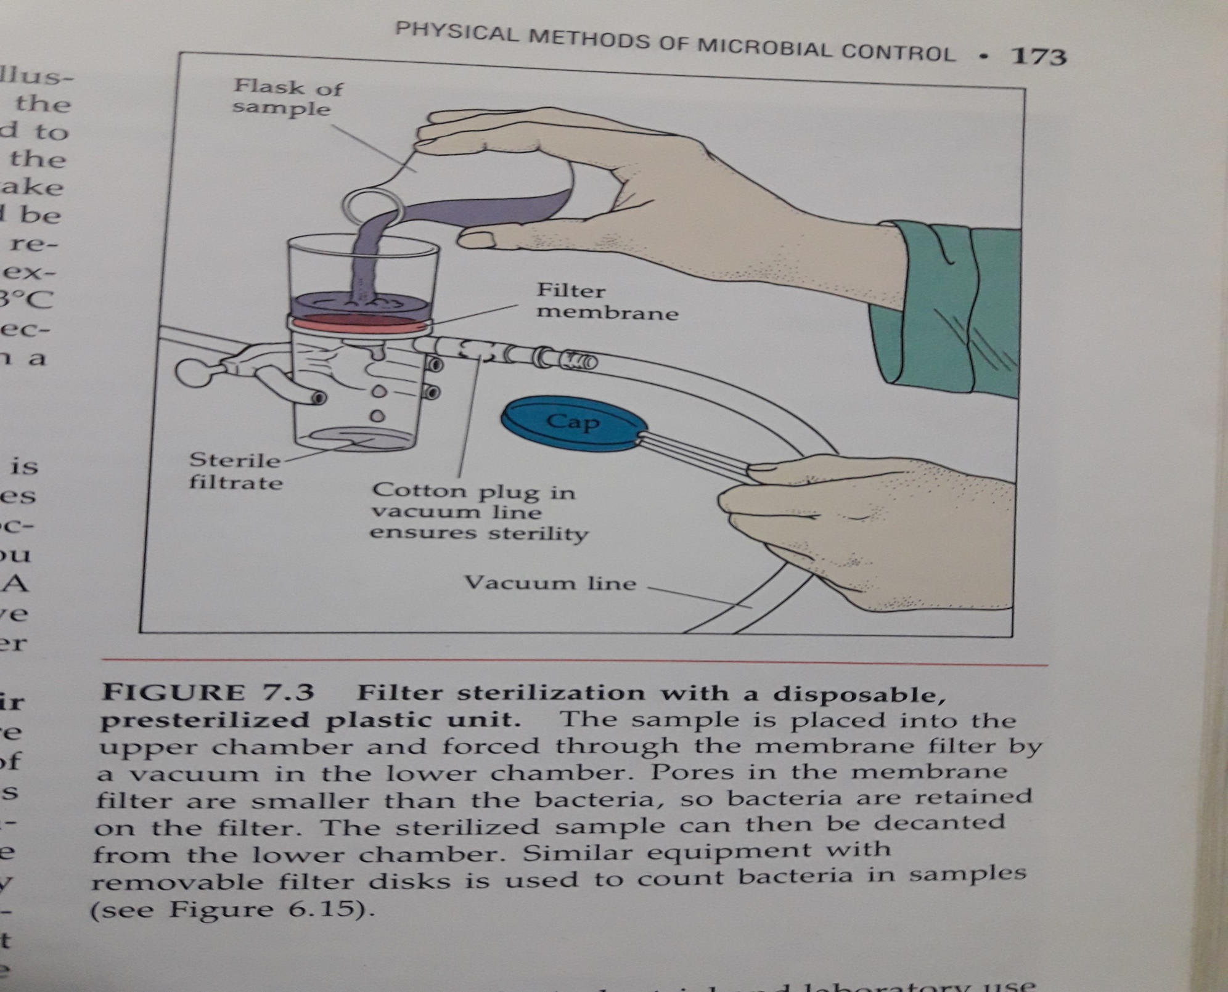
Figure 7.3

Slide 25
C- low Temperature
The effectiveness of low temperatures depends on the particular microorganisms and the intensity of the application.
Most microorganisms do not reproduce at ordinary refrigerator temperatures (0 to 7C).
Many microbes survive (but do not grow) at the subzero temperatures used to store foods.
Yet, psychrotrophs do grow slowly at a refrigerator temperatures and will alter the appearance and taste of foods after a considerable time. Some bacteria can grow at temperatures several degrees below freezing.

Slide 26
D- Desiccation
In the absence of water, microorganisms cannot grow but can remain viable.
Viruses and endospores can resist desiccation.
For example gonorrhea bacterium can with-stand dryness for only about an hour, but the tuberculosis bacterium can remain viable for months. Nomadic peoples such as some Native Americans used desiccation to preserve foods. They found that if meat is sliced thin and sun dried, it can be preserved for long periods.

Slide 27
E. Osmotic
Microorganisms in high concentrations of salts and sugars undergo plasmolysis.
Molds and yeasts are more capable of growing in materials with low moisture or high osmotic pressure than bacteria are.
The principle of osmotic pressure is used in the preservation of foods. For example, concentrated salt solution are used to cure meats, and thick sugar solutions are used to preserve fruits.
Molds and yeast are much more capable than bacteria of growing in materials with low moisture or high osmotic pressures. This property of molds, sometimes combined with their ability to grow under acidic conditions, is the reason fruits and grains are spoiled by molds rather than by bacteria.

Slide 28
F- Radiation
The effects of radiation depend on its wavelength, intensity, and duration.
Ionizing radiation (gamma rays and high-energy electron beams) has a high degree of penetration and exerts its effect primarily by ionizing water and forming highly reactive hydroxyl radicals.
Ultraviolet radiation, a form of nonionizing radiation, has a low degree of penetration and causes cell damage by making DNA thymine dimers that interfere with the DNA replication; the most effective germicidal wavelength in 260 nm.
Microwaves can kill microbes indirectly as materials get hot.

Slide 29
Chemical Methods of Microbial Control
Chemical agents are used on living tissue (as antiseptics and on inanimate objects (as disinfectants).
Few chemical agents achieve sterility.
Principles of Effective Disinfection
Careful attention should be paid to the properties and concentration of the disinfectant to be used.
The presence of organic matter, degree of contact with microorganisms, and temperature should also considered.

Slide 30
Evaluating A Disinfectant
The phenol coefficient is the comparison of one chemical’s disinfecting action with that of phenol, applied for the same length of time on the same organism under identical condition.
In the use-dilution test, a series of tubes contain increasing concentration of disinfectant; the more the chemical can be diluted and still be effective, the higher its rating.
In the filter paper method, a disk of filter paper is soaked with a chemical and placed on an inoculated agar plate; a clear zone of inhibition indicates effectiveness.

Slide 31
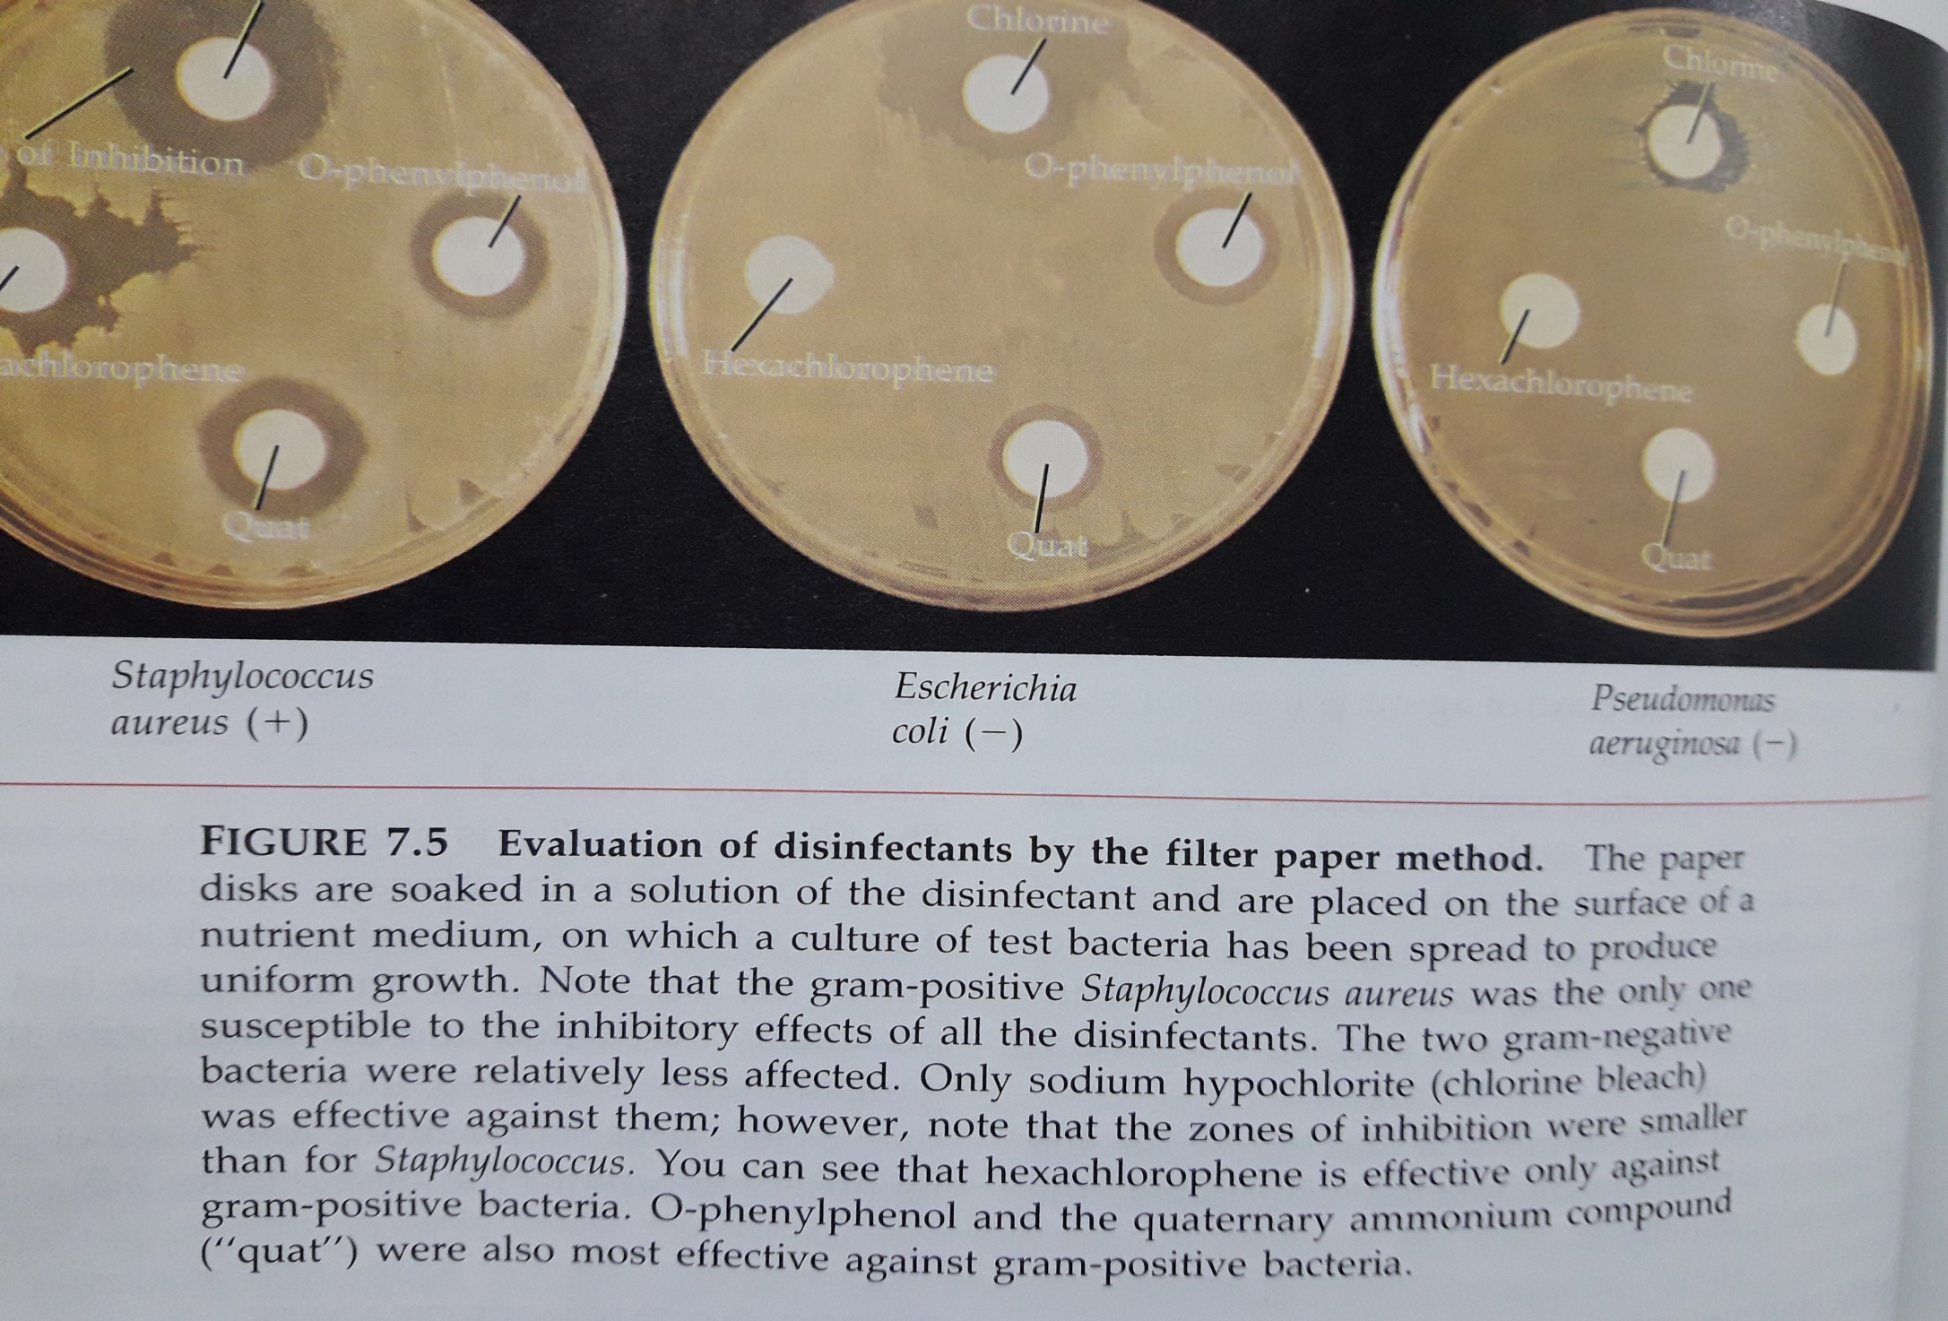
Figure 7.5

Slide 32
Types of Disinfectants
Phenol and Phenolics
Phenolics exert their action by injuring plasma membranes, inactivating enzymes, and denaturing proteins.
Common phenolics are cresols and hexachlorophene. Phenolics are derivatives of phenol.
Phenol (carbolic acid), is first used by Joseph Lister in his operating room. It is rarely used as antiseptic because irritates the skin.

Slide 33
b-Chlorhexidine.
It is used for disinfection of skin and mucous membranes as an alternative to hexachlorophene. It is combined with a detergent or alcohol for surgical hand scrubs and preoperative skin preparation in patients. The skin does not absorb it, and no toxicity has been reported.

Slide 34
c- Halogens
Some halogens (iodine and chlorine) are used alone or as components of inorganic or organic solutions.
To inactivate enzymes and other cellular proteins, iodine combines with the amino acid tyrosine.
Iodine is available as a tincture in solution with alcohol or as an iodophor (combined with an organic molecule).
The germicidal action of chlorine is based on the formation of hypochlorous acid (HOCl) when chlorine is added to water.
Chlorine is used as a disinfectant in gaseous form chlorine (Cl2) or in the form of a compound, such as calcium hypochlorite [Ca(OCl)2], sodium hypochlorite (NaCl) (Clorox), and chloramines.
Chloramines consist of chlorine and ammonia. They are used as disinfectants, antiseptics, or sanitizing agents.

Slide 35
Chloramines are very stable compounds that release chlorine over long periods. They are relatively effective in organic matter, but they have the disadvantages of acting more slowly and being less effective purifiers than many other chlorine compounds. Chloramines are used to sanitize glassware and eating utensils and to treat dairy and food-manufacturing equipment.

Slide 36
d-Alcohols
Alcohols exert their action by denaturing proteins and dissolving lipids.
In tinctures, they enhance the effectiveness of other antimicrobial chemicals.
Aqueous ethanol (60% to 95%) and isopropanol are used as disinfectants.

Slide 37
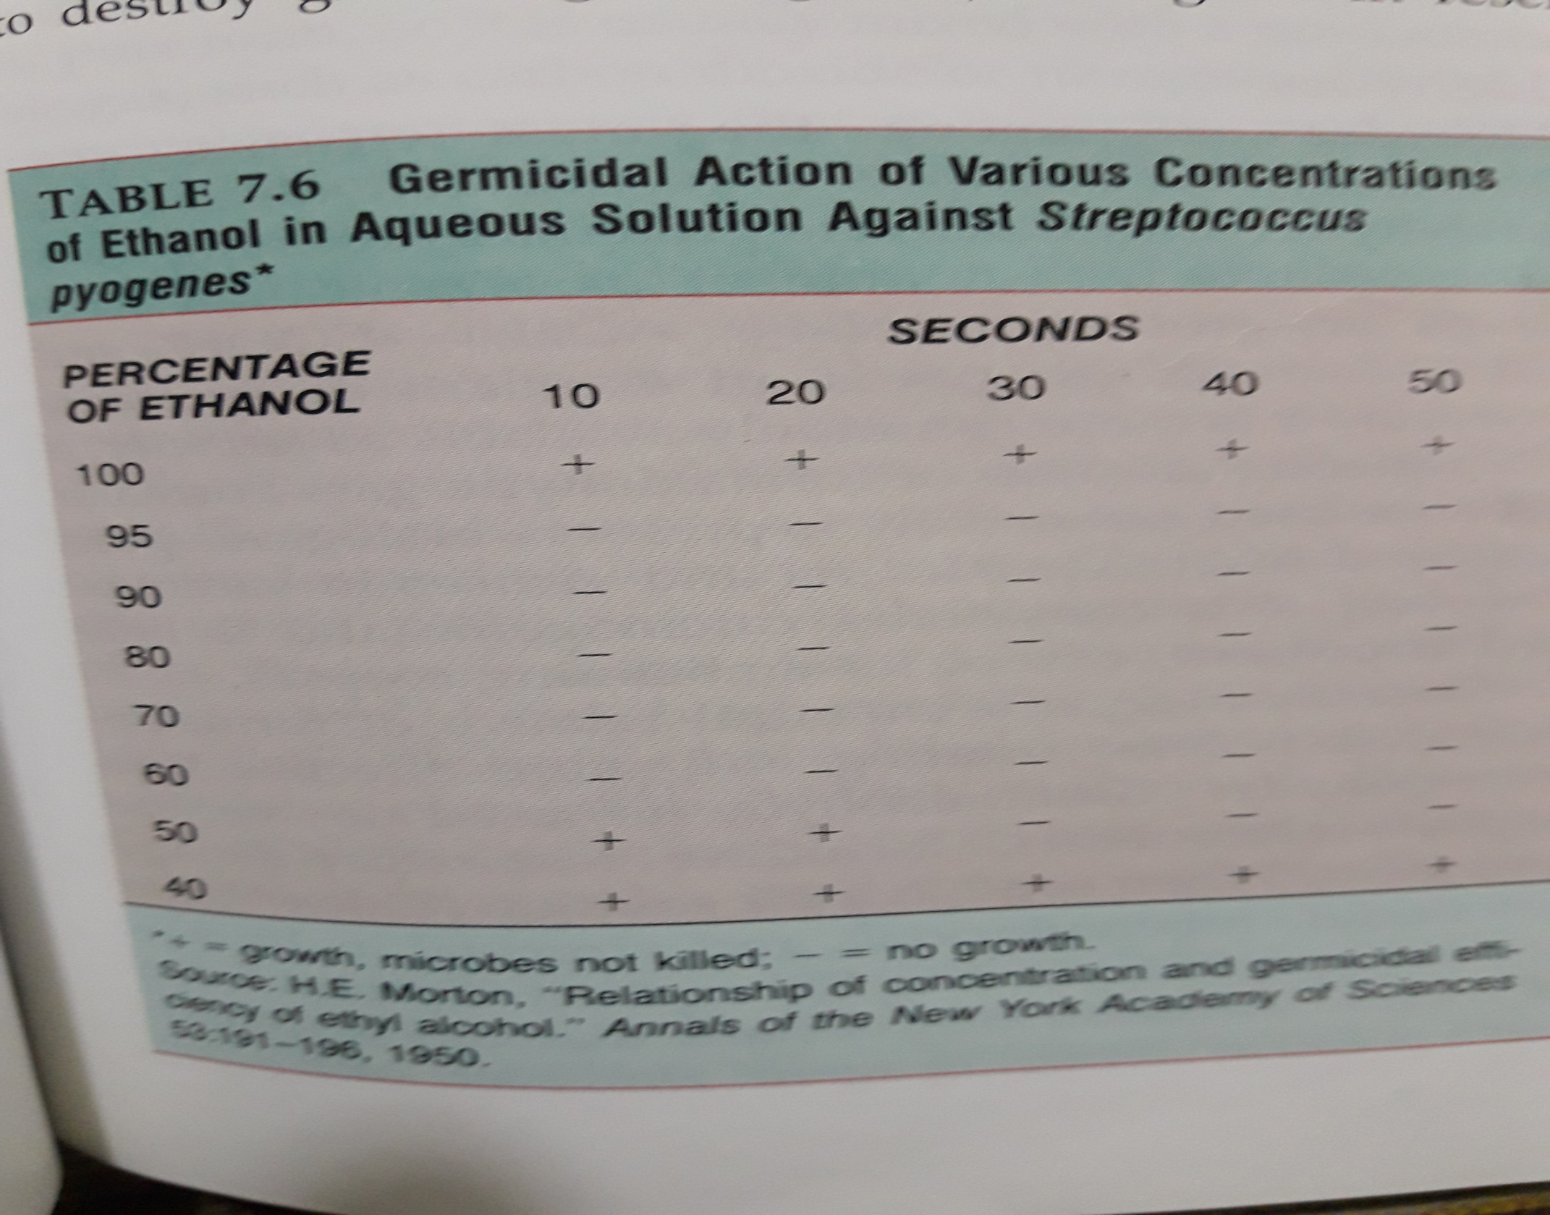
Table 7.6

Slide 38
e-Heavy Metals and Their Compounds
silver, mercury, copper, and zinc are used as germicidals or antiseptics.
They exert their antimicrobial action through oligodynamic action. When heavy metal ions combine with –SH groups, proteins are denatured.
For example, 1% silver nitrate, mercuric chloride, and copper sulfate.

Slide 39
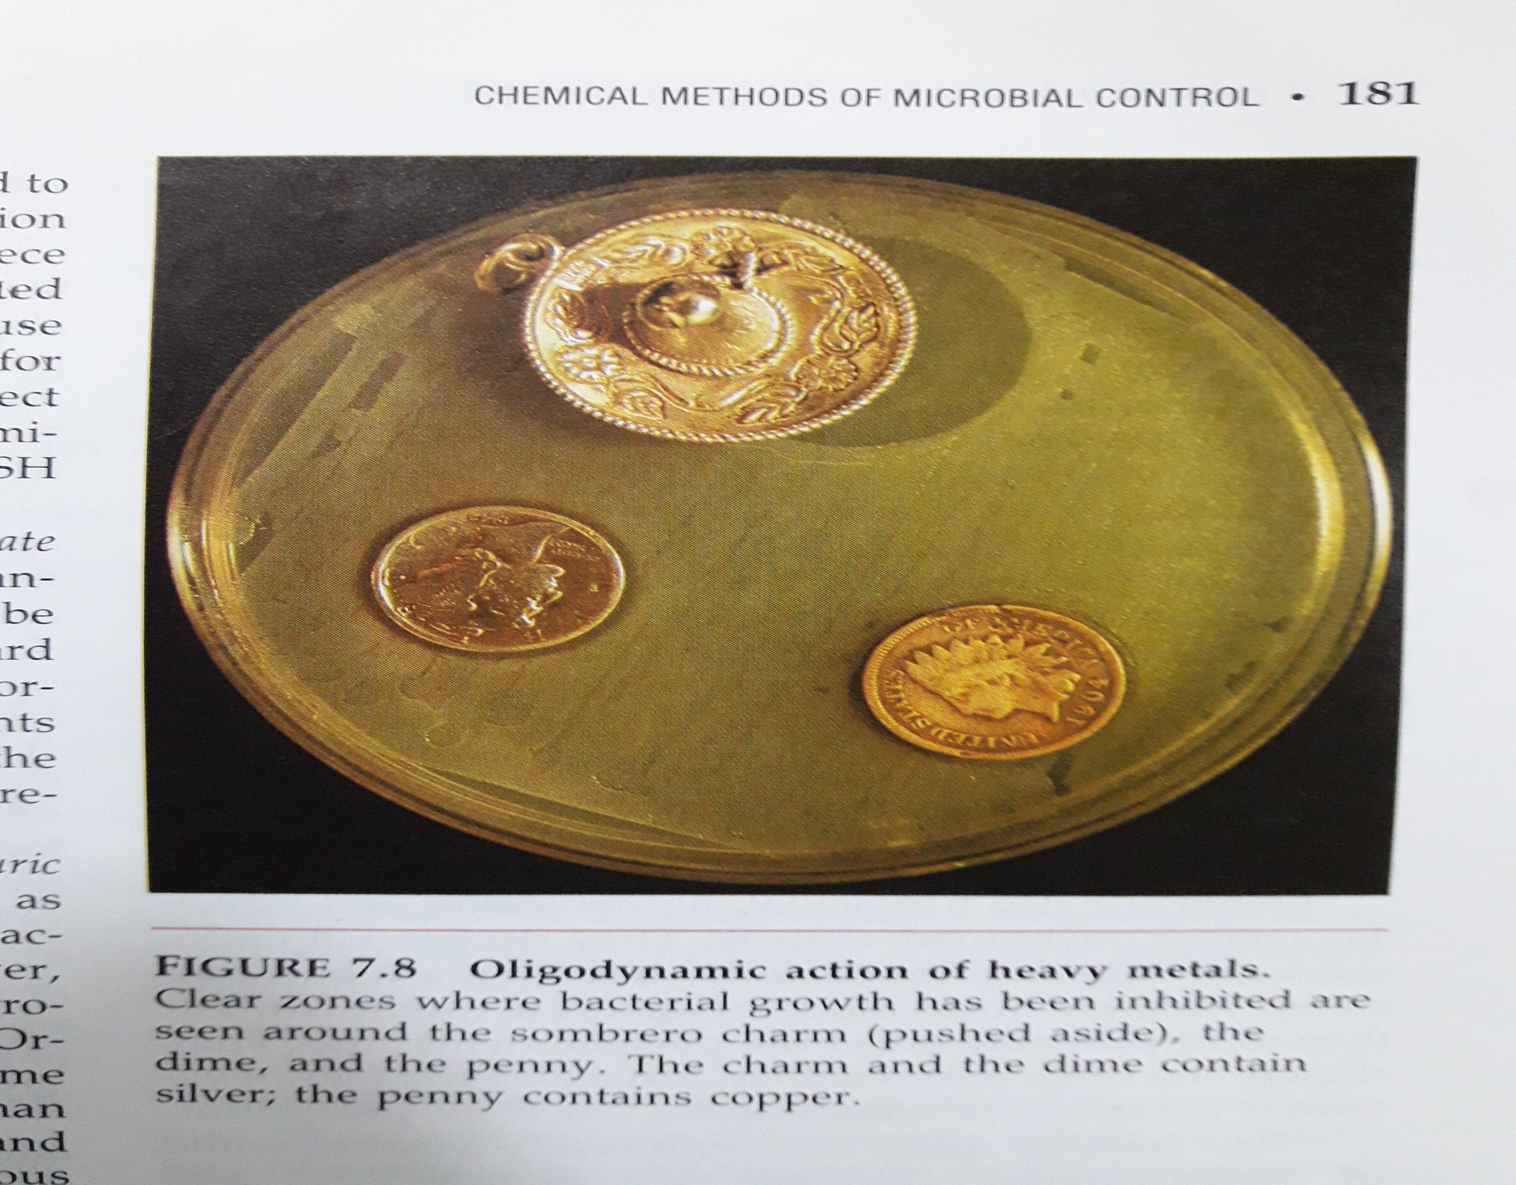
Figure 7.8

Slide 40
1% silver nitrate solution is bactericidal for most organism. Inorganic mercury compounds, such as mercuric chloride, probably have the longest history of use as disinfectants. They have a very broad spectrum of activity; their effect is primarily bacteriostatic. However, their use is now limited because of their toxicity, corrosiveness, and ineffectiveness in organic matter.
For example: Mercurochrome, Merthiolate
Copper in the form of copper sulfate is used chiefly to destroy green algae (algaecide) that grow in reservoirs, swimming pools, and fish tanks.
Another metal used as an antimicrobial is zinc. Zinc chloride is a common ingredient in mouthwashes, and zinc oxide is probably the most widely used antifungal.

Slide 41
f- Surface-Active Agents (surfactants).
surface-active agents decrease the tension between molecules that lie on the surface of a liquid; soaps and detergents are examples.
Soaps have limited germicidal action but assist in the removal of microorganisms through scrubbing. Many so-called deodorant soaps contain compounds such as triclocarban that strongly inhibit gram-positive bacteria
Acid-anionic detergents are used to clean dairy equipment.

Slide 42
g-Quaternary Ammonium Compounds
Quats are cationic detergents attached to NH4+
By disrupting plasma membranes, they allow cytoplasmic constituents to leak out of the cell.
They are most effective against gram-positive bacteria.
Quats cleansing ability is related to the positivity charged portion-the cation- of the molecule. Their name comes from the fact that they are modifications of four-valence ammonium ion, NH4+. Two popular quats are Zephiran and Cepacol.

Slide 43
h-Organic Acids and Derivatives
A number of organic acids are used as preservatives to control mold growth. Sorbic acid (potassium sorbate) is used to inhibit mold growth in acidic foods, such as cheese.
Benzoic acid (sodium benzoate) is an antifungal that is effective at low pH.
The parabens, such as methylparaben and propylparaben, are often used to inhibit mold growth in liquid cosmetics and shampoos.
Generally, they inhibit the enzymatic and metabolic activity of organisms.

Slide 44
i-Aldehydes
1.Aldehydes such as formaldehyde and glutaraldehyde exert their antimicrobial effect by inactivating proteins.
2.They are among the most effective chemicals disinfectants.
3.They inactivate proteins by forming covalent crosslinks with a number of organic functional groups on proteins.
4. Formaldehyde gas is an excellent disinfectant. It is more commonly available as formalin, a 37% aqueous solution of formaldehyde gas.
5.Glutaraldehyde is a chemical relative of formaldehyde that less irritating and more effective than formaldehyde. It is used to sterilize hospital instruments, including respiratory-therapy equipment. When used in a 2% solution (Cidex), it is bactericidal, tuberculocidal, and viucidal in 10 minutes and sporicidal in 3 to 10 hours.

Slide 45
j-Gaseous Chemosterilizers
Ethylene oxide is the gas most frequently used for sterilization.
It penetrates most materials and kills all microorganisms by protein denaturation.
Materials to be sterilized with ethylene oxide must be exposed to it for 4 to 18 hours.
Because of their ability to sterilize without heat, gases like ethylene oxide are also widely used on medical supplies and equipment like plastic-ware, such as syringes and Petri plates, textiles, sutures, lensed instruments, artificial heart valves, heart-lung machines, and mattresses.

Slide 46
K-Oxidizing Agents
Ozone and peroxide are used as antimicrobial agents.
They exert their effect by oxidizing molecules inside cells.
Ozone (O3) is a highly reactive form of oxygen that is generated by high-voltage electrical discharges.
Hydrogen peroxide is an antiseptic found in many household medicine cabinets and in hospital supply rooms. It is not a good antiseptic for open wounds because it is quickly broken down to water and gaseous oxygen by the action of the enzyme catalase.

Slide 47
THANK YOU

